Slide 1
Minimum spanning Tree: Kruskal and prims algorithm.
Tilak Poudel
Roll no. 39

Slide 2
Let’s explore
What Minimum spanning Tree (MST) is?
What’s the the key behind MST?
Kruskal’s Algorithm – Think Edge-first
Prim’s Algorithm – Think Node-first
Time Complexities

Slide 3
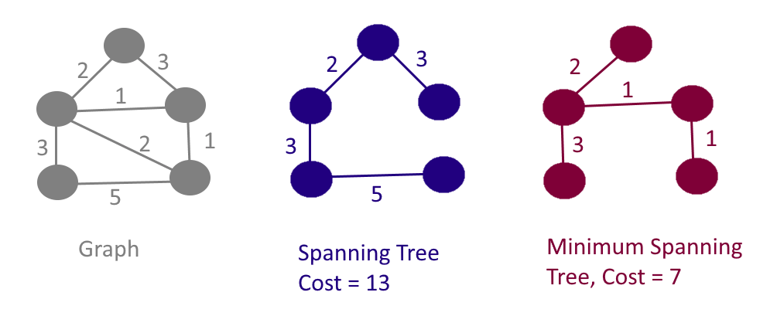
1. What is a Minimum Spanning Tree (MST)?
An MST is a subset of the edges in a connected, weighted graph that:
Connects all the vertices (i.e., it’s a spanning tree)
Has no cycles
Has the minimum total edge weight.

Slide 4
2. Greedy Algorithms Are Key
Kruskal’s and Prim’s are both greedy algorithms.
Greedy = make the best local choice (i.e., minimum edge) at each step to build the MST.

Slide 5
3. Kruskal’s Algorithm – Think Edge-first
Sort all edges by weight (ascending).
Add the smallest edge that doesn’t form a cycle (use Disjoint Set / Union-Find to detect cycles).
Repeat until V - 1 edges are included (where V = number of vertices).
💡 Use Kruskal's when:
The graph is sparse.
The edges are given or easy to sort.

Slide 6
4. Prim’s Algorithm – Think Node-first
Start from any vertex.
Use a priority queue (min-heap) to pick the smallest edge connecting visited and unvisited nodes.
Add that edge to the MST and mark the vertex as visited.
Repeat until all vertices are visited.
💡 Use Prim's when:
The graph is dense.
You're given an adjacency matrix or list.

Slide 7
5. Time Complexities
Kruskal’s : O(E log E) (sorting edges) + DSU operations.
Prim’s : O(E log V) using a min-heap (priority queue).

Slide 8
Any queries?
Thank You

